Slide 1

Customer Review Analysis

Slide 2

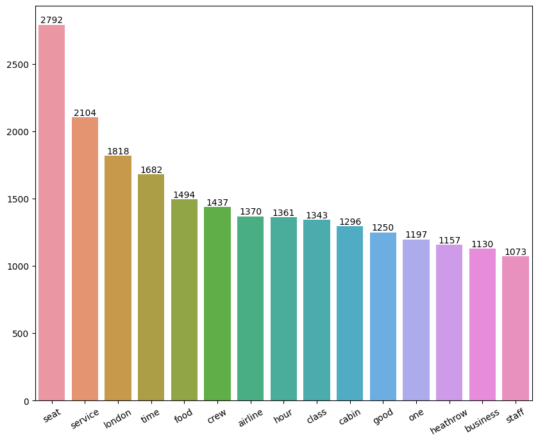
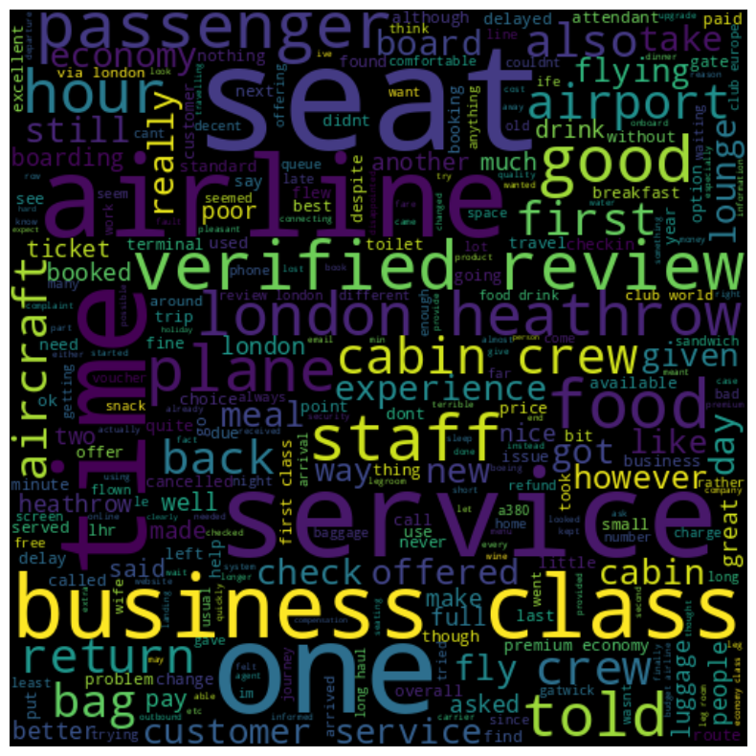
Task 1: Web scraping to gain company insights
All customers like the cabin crew's service and staff, as well as the general economy seats. Many people travelled in Business Class.
Need to Focus on – Economy class service, enhance inflight entertainment, Improving the experience of business class, Enhance Customer service on refund requests and process.
2500 Total reviews
collected
Verified Trips – 1199 out of 2500

Slide 3
Task 2: Predicting customer buying behaviour
All customers like the cabin crew's service and staff, as well as the general economy seats. Many people travelled in Business Class.
Need to Focus on – Economy class service, enhance inflight entertainment, Improving the experience of business class, Enhance Customer service on refund requests and process.
2500 Total reviews
collected
Verified Trips – 1199 out of 2500

